Slide 1
Ver 040315

Slide 2
Overall:
Text font: Helvetica. Still not implemented at this stage.
Urgent stuffs that we hope to see by 5th/6th March are the points labeled in red.
Do let us know specifically what are the graphic elements that you need hires from us.
Do have some inputs. Do let us know what works best from your programming standpoint.
I think as long as make the user flow as tight as possible, it will be good for everyone.

Slide 3
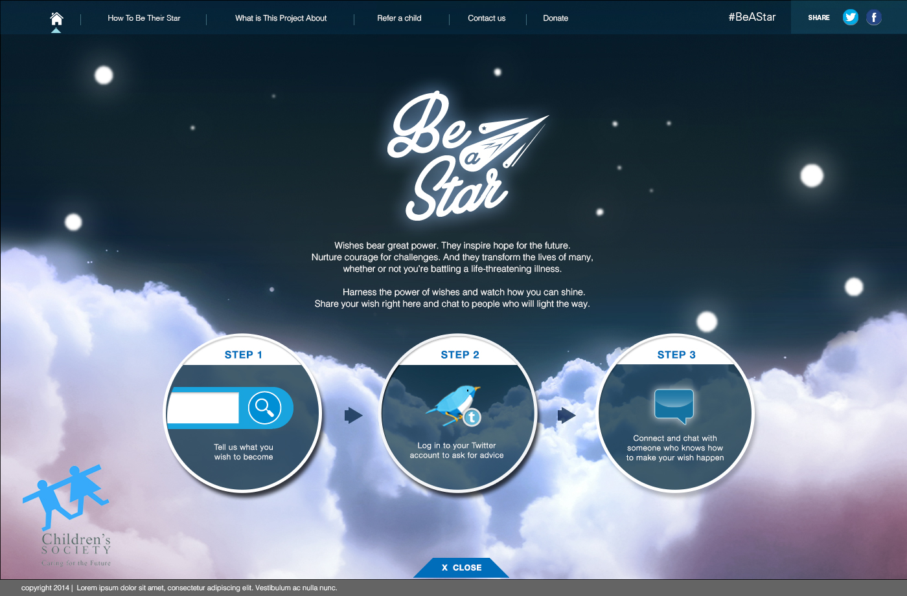
3
4
1
2
1
Please note the change in client logo.
2
Understand this is a WIP in the current staging. Just checking how confident you guys in achieving this? http://www.drinksmartwater.com/#/explore-the-sky
No so much the interactivity ( how the mouse contorl the camera, it’s a good to have, but not priority) but the generating of the cloud visual via HTML 5. Do let us know what can be achieved by next week? At least we set expectation.
3
I do not see the gradient background in the current staging. Are you expecting a higher resolution from us? If we please do let us know what is the dimension you need us to create the image in? 2000x1100?
4
If the site is sizable to different browser size, what is the resolution should I pass the asset to you… Do let us know.

Slide 4
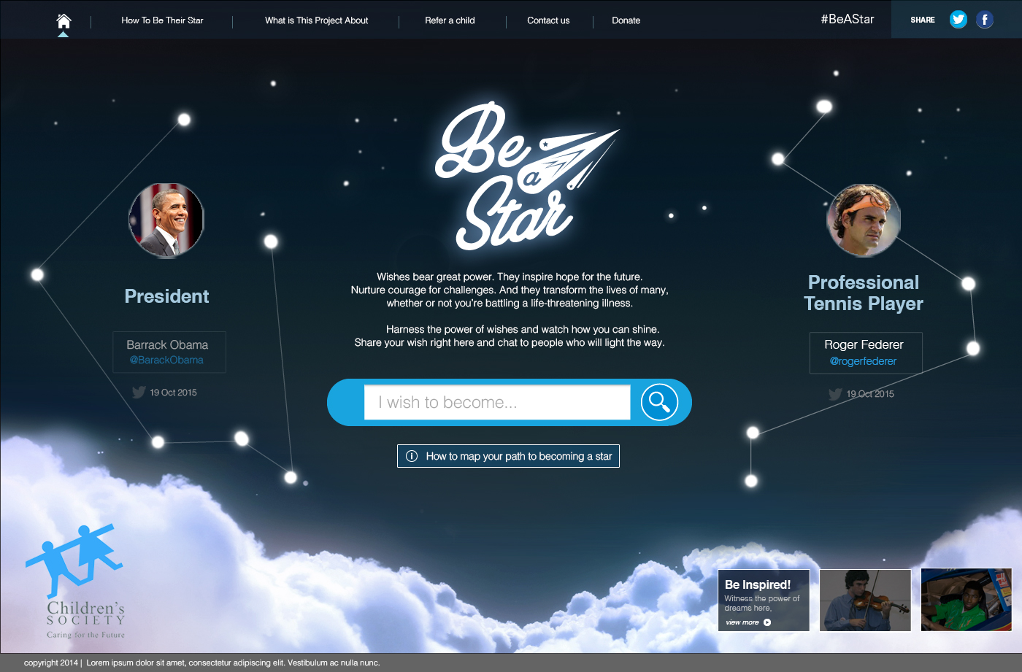
1
3
2
1
We are thinking this should be a image pulled from the respective Twitter account profile. Do let us know if this is too huge in dimension? We can change the design so that the a correct sized sharp image appears.
2
This is key. Can we make sure we see this dream path concept by next Monday? We are envisioning that the dots appear, then the line connects them together as a animation piece.
3
In the current staging, we have to delete the text before we can type.
Can you program it in a way that once you click on the text “ I wish to become” it disappears.

Slide 5
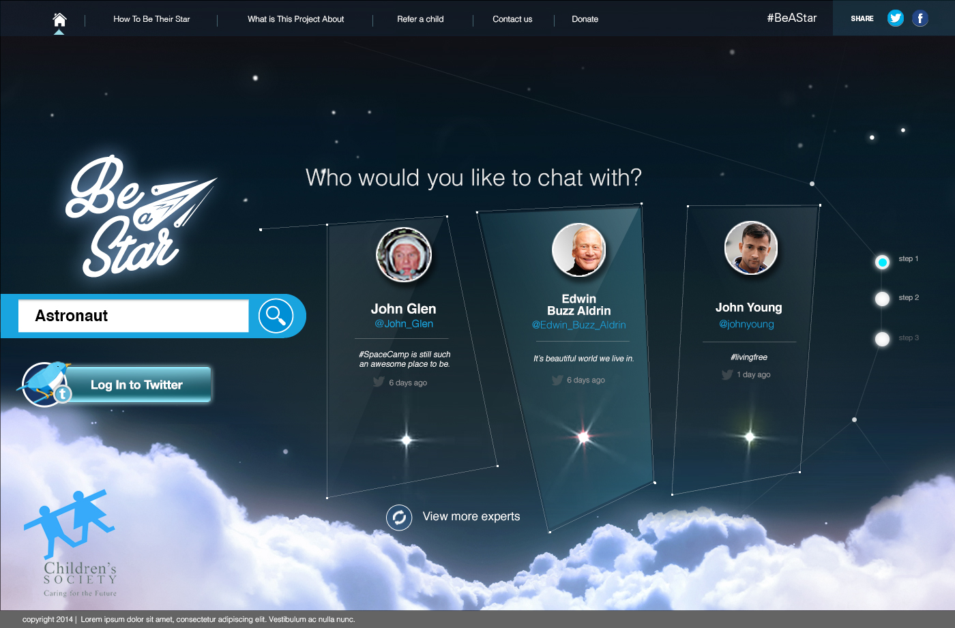
1
2
3
5
4
1
For the lock up and logo, we need to think of an animation that makes them re-appears on the side. At thinking that they disappear from the previous from and slides in ( off frame) from left to right – like a drawer effect.
2
3
I understand from the previous email that we wanted to merge page 3 and 4 together. But think about it again…technically, once we click the expert’s box, it should immediately lead us to the Twitter Login page. ( next slide)… so am thinking the login-button as a supplementary only.
4
Acknowledge this is a shitty lores image. But perhaps we can see what are ALL the lores image than I give to you guys at one shot to make sure we don’t miss out anything at a later stage.
5
Please do let us know what is the best format to pass these super bright stars to you? Animated gifs? Pngs?..etc.

Slide 6
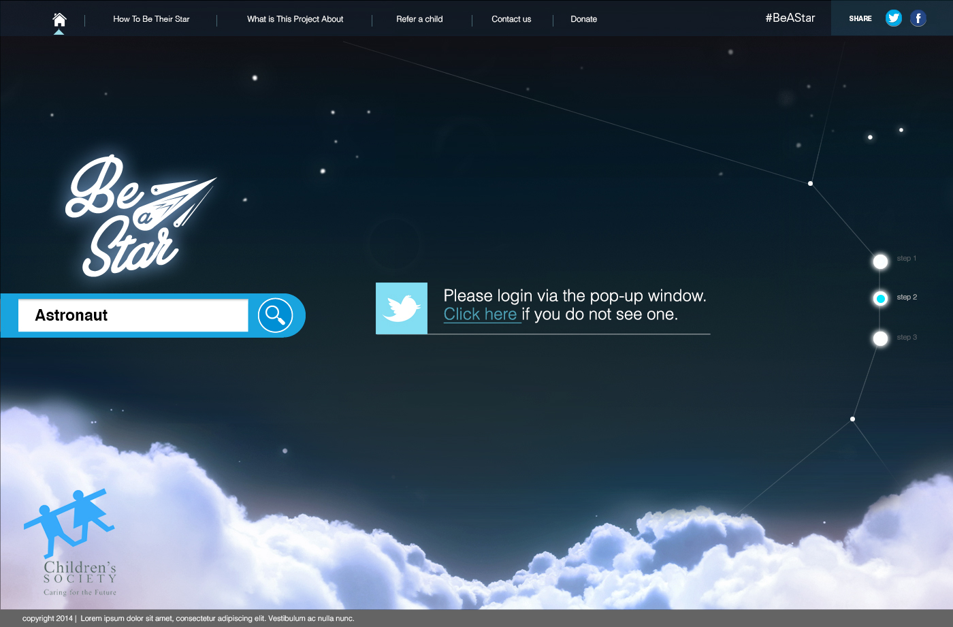
1
1
From the mocks, I would presume that the login box will be a pop up box?
So question:
Will a pop-up blocker hinder the appearance of the login window?
Or do we create an iFrame to call the Twitter login into the site through a <container>.
Do let us know what you think so that we can design an optimized site.

Slide 7
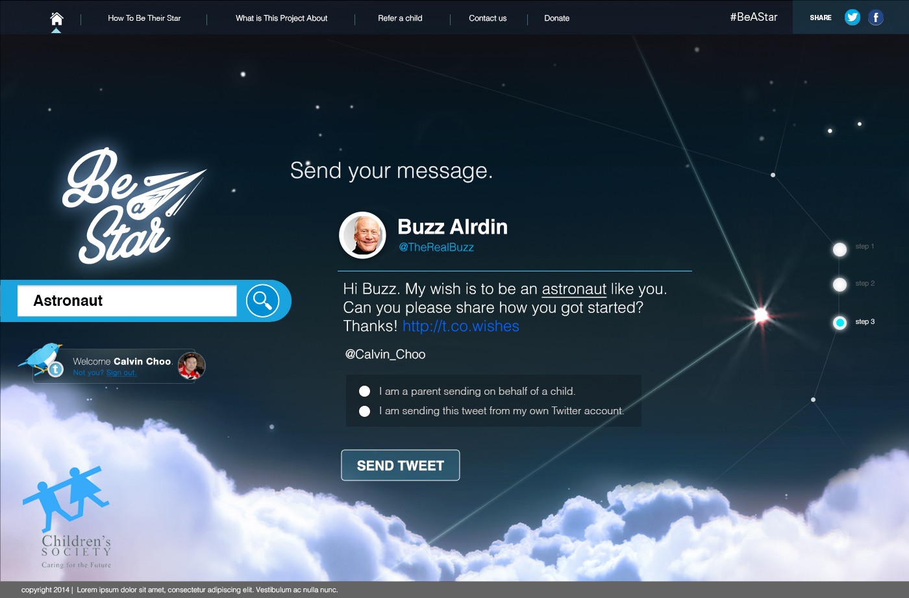
4
2
5
3
1
1
2
As discussed. We need a radio box here that would technically change the preset message ( noted on the 144 char limit).
So we will give you 2 x message that will change according to the radio box the user select.
Question:
Can you retrieve the “name” of the selected Twitter Expert to be included in this custom message. ( see “Hi Buzz”)
3
Will keep this as a login lockup once the end-user logs in to his/her Twitter account.
4
5
We are imaging this to be a random animation that is programmed. So that every time this is login’ed…. The line and animation is different.

Slide 8
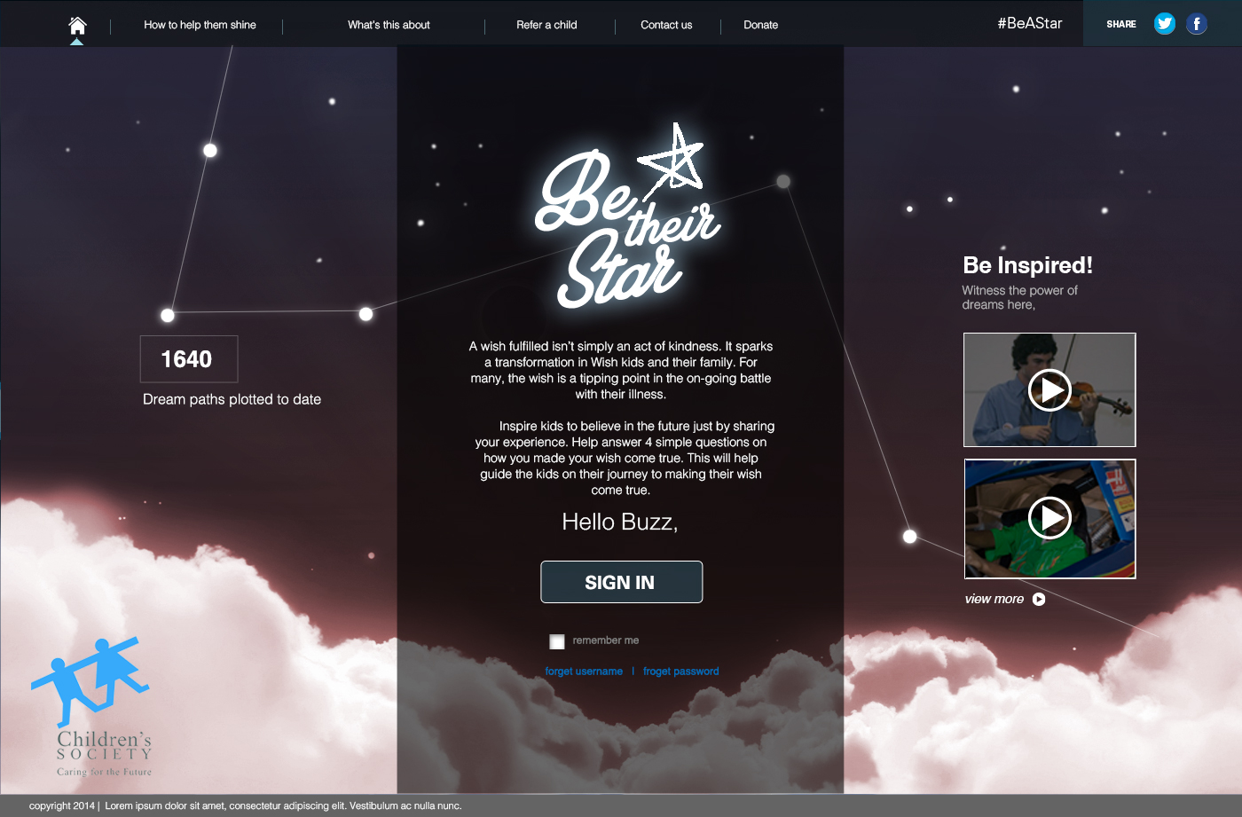
2
4
1
3
1
Will you guys be able to pull the name of the Expert based on the programming and Bitly link? Makes it a lot more personable.
2
Am expecting this to be animated out when this expert page is loading… we need to achieve this through programming.
3
Please note the color change in the clouds in the experts page. To serve as differentiation.
4
Can we consolidate the total numbers of request + dream paths to make the site more bleiveabale.

Slide 9
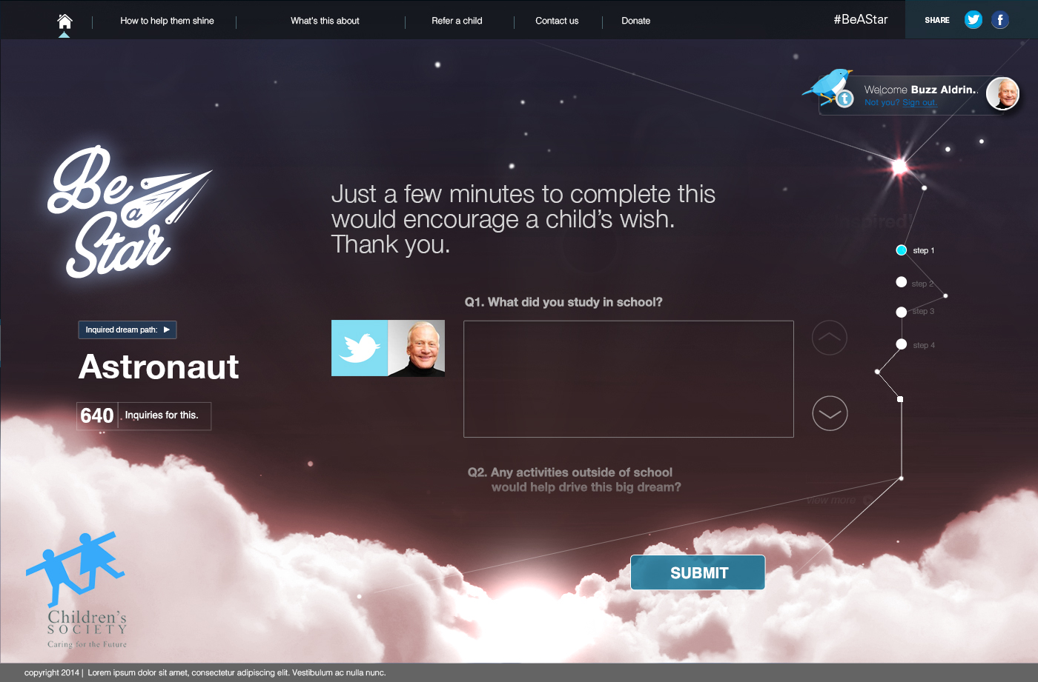
4
3
1
2
1
Will you guys be able to pull the name of the Expert based on the programming and Bitly link?
2
Can we set a parameter whereby submit only appears when experts fill up all 4 questions?
3
A small data pull from how many kids requested for that job…. Can we pull that data?
4
If we do the add more questions section, can the steps on the side increase accordingly? How ill it affect the programm lines.

Slide 10
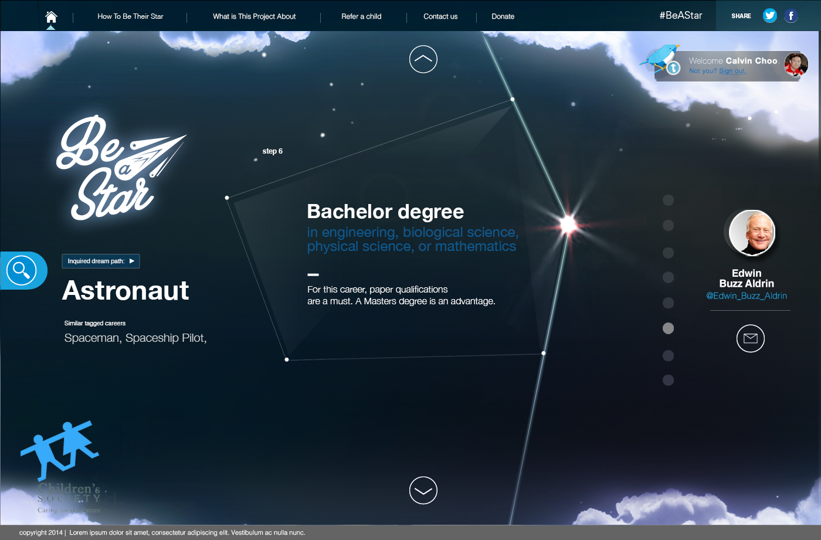
5
Can we explore a way to be able to send this information to their own email for future references.
A PDF file will work. Or they could print as PDF or just a link to their inbox that leads directly to this “astronaut” page only.
3
4
5
2
1
1
Can we add a “zoom out” button to see all the entire timeline in totality then a zoom in button to focus on 1 milestone.
2
We are also thinking that these lines and dots are randomized.. How are you guys are confident to deliver?
3
Again, what format to pass you guys these “bright stars”
4
In the admin panel, can we also add “tags” that is associated with this job title.. So during search the same job will not pop up twice.

